Slide 1
How DOAJ provides quality assurance and visibility for Portuguese journals
November 2024

Slide 2
80
135
21,000
languages
countries
More than
journals

Slide 3
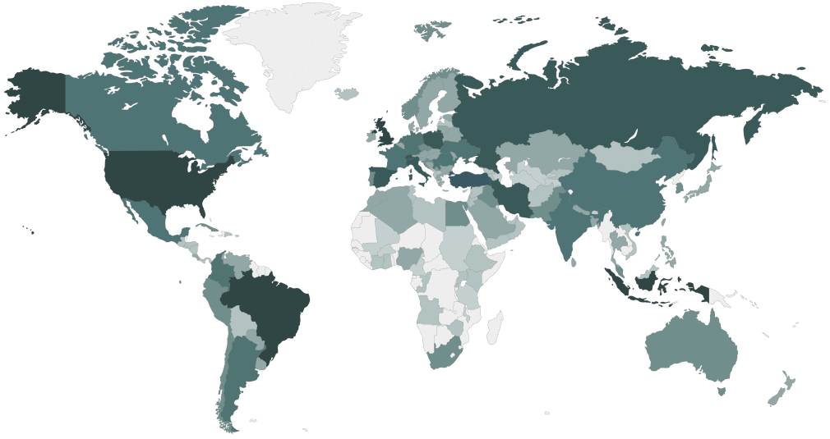
Overview of publisher countries indexed in DOAJ
Data collected 20th February 2024

Slide 4
DOAJ statistics 2023
7,926 applications & 4,126 update requests from journals
24% of applications accepted for inclusion
Average review time under three months
20 core staff, >100 volunteer editors & 12 ambassadors

Slide 5
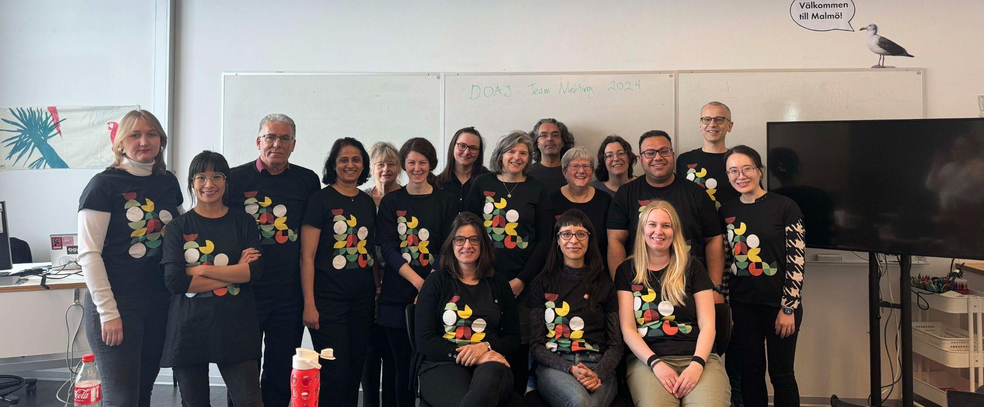
DOAJ team
Team photo taken during a team meeting in Malmö in April 2024

Slide 6
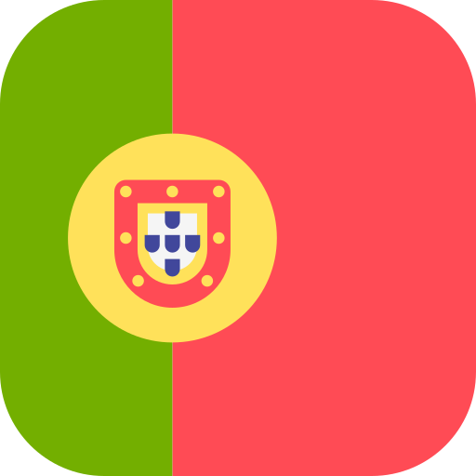
DOAJ and Portugal
Index contains 169 journals from Portugal, 148 of which charge no APC
Portuguese is the third most common language used by journals in DOAJ
We received 52 applications and added 10 journals from Portugal to the index in 2023
3 volunteer editors from Portugal support the reviewing of applications
Notes:
In 2022 over 8,000 journals applied to be indexed in DOAJ, and every one of those applications was handled by a volunteer and/or a Managing Editor.

Slide 7
DOAJ’s evaluation criteria are a gold standard for open access publishing
They cover…
Open Access, copyright and licensing
Transparency: editorial board, peer review, and journal ownership
Editorial and publishing standards
Website and functionality
Operations: editorial independence, business model and archiving

Slide 8
Why index journals in DOAJ?
Demonstrate your journal meets good publishing standards
Attract more authors and readers locally and from around the world
Inclusion of Journals in local languages
Increase discoverability of your journal in search engines and indexing services
Enhance the reputation and societal impact of your journal (also in your country)
DOAJ index included in government lists like DHET(South Africa)

Slide 10
DOAJ metadata is used and reused across the scholarly community

Slide 11
DOAJ as an open scholarly infrastructure…
1
cannot be bought or sold.
2
is committed to openness, diversity and accountability.
3
has adopted the Principles of Open Scholarly Infrastructure in 2022.
4
collaborates with other open infrastructures to drive change towards an open and transparent culture.
Notes:
Collaborates: eg author of Principles of Transparency and Best Practice in Schol. Publishing and founding organisation of Think.Check.Submit

Slide 12
DOAJ criteria, application process, and (sometimes) rejection help journals increase their own standards.

Slide 13
“
DOAJ indexing was a difficult but doable process. We enjoyed working with the DOAJ team as support in the work process.
”

Slide 14
DOAJ Review and decision
Application
Initial checks
Independent review
Final decision
Feedback
Publisher/editor
DOAJ Triage team
DOAJ Editorial team
DOAJ Managing Editor
Publisher/editor

Slide 15
“
Firstly, our application was rejected, as we did not have proper copyright arrangements. After that, we consulted with some experts and lawyers, adopted the CC copyright model, and arranged everything else in order to really become an open access journal.
”
Feedback collected between 31st Jan - 14th Feb 2023, from survey on journals indexed in DOAJ 1st Jan to 30th June 2021.

Slide 16
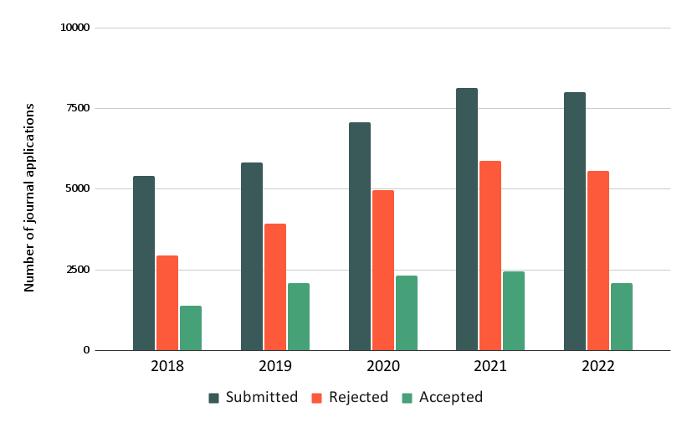

Slide 17
Our specially trained quality team investigated over 400 cases of suspected questionable practices in 2023

Slide 18
How librarians and research support staff use DOAJ
Our metadata is integrated with library discovery systems & gives users access to a more diverse range of content
Our metadata is used in other systems used by libraries and enabling a transition to OA, eg. Unpaywall, Plan S Journal Checker Tool, OpenAPC

Slide 19
DOAJ is a source of trusted quality journals when advising researchers where to publish
Checking for inclusion in DOAJ is embedded in Open Access workflows, i.e. allocating funding for APCs

Slide 20
DOAJ and the community
Founders of
Partners of

Slide 21
https://www.oajournals-toolkit.org/
Self-guided online resource
Launched in 2023 by OASPA and DOAJ
Content created by a diverse Editorial Board of experts in the field
Editorial Board responsible for keeping the content up to date
Available in English, French and Arabic
Soon available in Spanish and Portuguese

Slide 22
Supporting DOAJ

Slide 23
How DOAJ is funded
600+ University libraries from 36 countries
17 Library Consortia from 13 countries
10 Research Funders/Academies of Science
30+ smaller publishers
25+ larger publishers and aggregators
80% of income from the community
20% of income from publishers
Running DOAJ cost €1.3m in 2023

Slide 24
Why support DOAJ?
1
Funding from libraries enables our commitment to being 100% independent.
2
Our core data and services can remain open and free to everyone.
3
DOAJ has been created and is developed by the community and it develops in line with community values.

Slide 25
Why support DOAJ?
4
Supporting open infrastructure is a strategic choice for libraries, and demonstrates a commitment to open research and a sustainable future for open infrastructure.
5
Demand for (and pressure on) our services is increasing in line with the growth of Open Access.

Slide 26
Institutional and library supporter rates
€4000 large institutions
€2000 small institutions

Slide 27
Further information or questions?
Joanna Ball Managing Director
joanna@doaj.org

